Slide 1


Fashion Item Classification using Fashion MNIST
Image Classification with Machine Learning
Presented by: Group 12
Submitted to : Mr. Bikki Gupta Sir
Aditya Singh Sikarwar
Aastha
Amrendra Singh
Animesh Chandra Srivastava
Ankush Gupta

Slide 2




Problem Statement
Our goal is to Build a model to automatically recognize clothing items like shirts, shoes, and bags from images.
Helps in online retail (auto-tagging, recommendations)
Reduces manual labeling of fashion images.
Enhances visual search features in shopping apps

Slide 3

Introduction to Fashion MNIST
Fashion MNIST is a dataset provided by Zalando. It serves as an alternative to the original MNIST dataset. It contains 70,000 grayscale images.
70K
10
Images
Categories
Total grayscale images.
Different fashion items.
60K
28x28
Training Set
Pixel Size
Images for model training.
Resolution of each image.

Slide 4
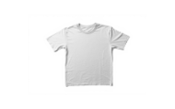
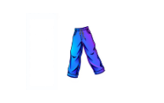
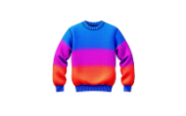
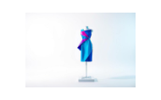
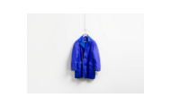
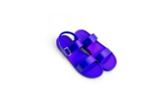
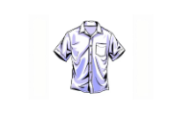
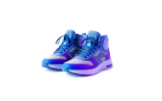
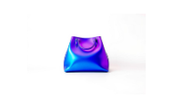
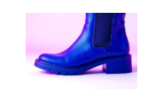
Sample Images from Dataset
Here are example images from each of the ten distinct classes. The dataset is balanced, ensuring fair representation for each category.

Slide 5




Methodology Overview
Our model utilizes a Convolutional Neural Network, or CNN, for image classification. It processes images efficiently.
Load and preprocess data
Build and train the model
Evaluate model performance
Visualize results using confusion matrix

Slide 6
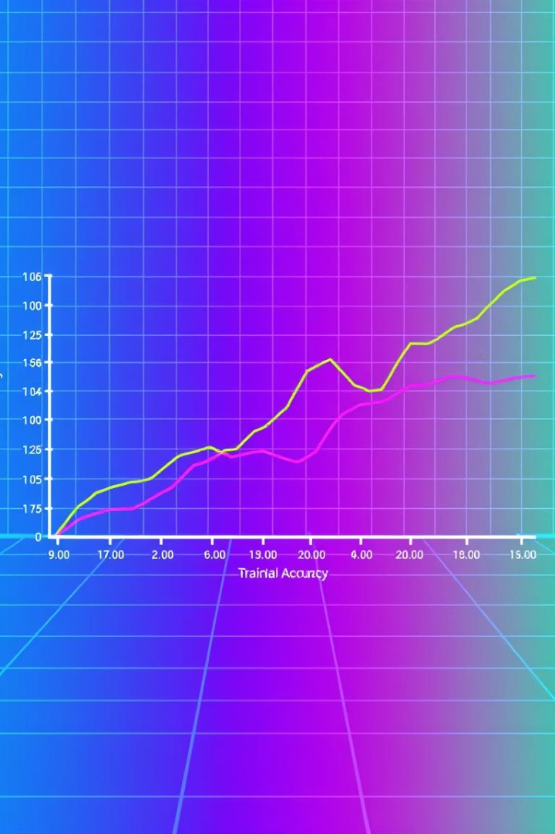
Training Details
The model was trained using 20 epochs with a batch size of 128. We achieved strong validation accuracy.
Data Split
80% Training, 20% Validation
Optimizer
Adam
Loss Function
Categorical Cross-Entropy
Epochs
20
Batch Size
128
Validation Accuracy
91%

Slide 7





Results
Our model achieved an impressive overall test accuracy of 91.5%. Ankle boots were the best-performing class.
Overall Accuracy
Confusion Matrix
Metrics Per Class
Achieved 91.5% on the test set.
Visualizes classification performance per class.
Precision, recall, and F1-score provided.
Top Performer
Lowest Performer
Ankle boot with 95% accuracy.
Shirt with 85% accuracy.

Slide 8
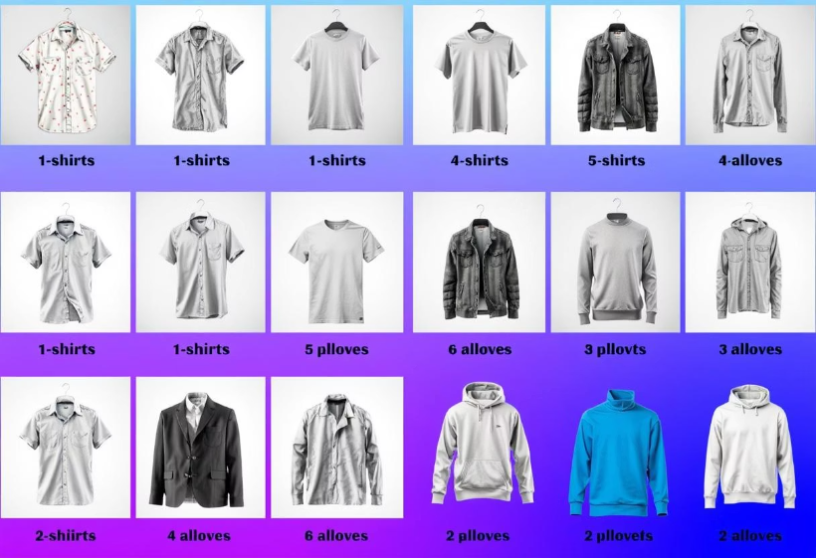
Error Analysis
We identified common misclassifications by visualizing problematic examples. Similar visual features often led to confusion.
Misclassified Examples
Visual review of incorrectly predicted images. Highlights where the model struggled.
Shirt vs. T-shirt/Top confusion.
Coat vs. Pullover confusion.

Slide 9
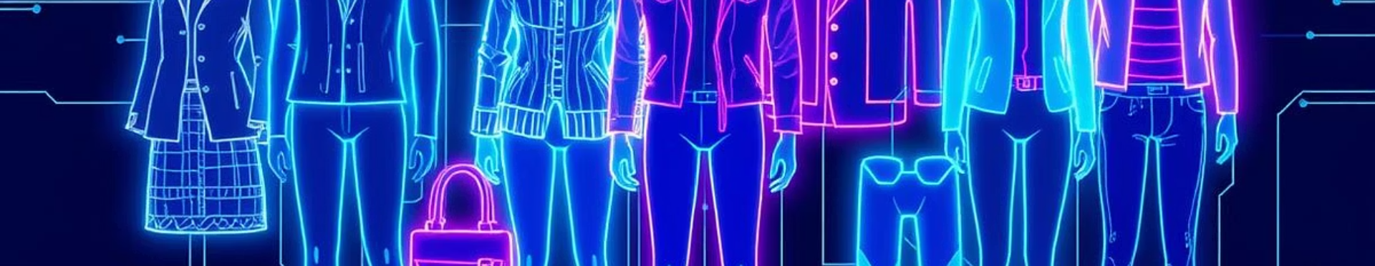




Future Work
We plan to enhance model performance and explore deployment options. Our focus is on continuous improvement.
Data Augmentation
New Architectures
Transfer Learning
Model Deployment
Explore techniques to expand training data.
Experiment with advanced CNNs like ResNet.
Utilize larger fashion datasets for pre-training.
Implement for real-time recognition.

Slide 10







Conclusion
We successfully built a robust CNN model for fashion item classification. It shows significant potential for real-world applications.
CNN Success
High Accuracy
1
Successfully developed a CNN model.
Achieved strong results on Fashion MNIST.
E-commerce Impact
Fashion Industry
Promising applications in online retail.
Valuable tool for the fashion sector.

